Slide 1
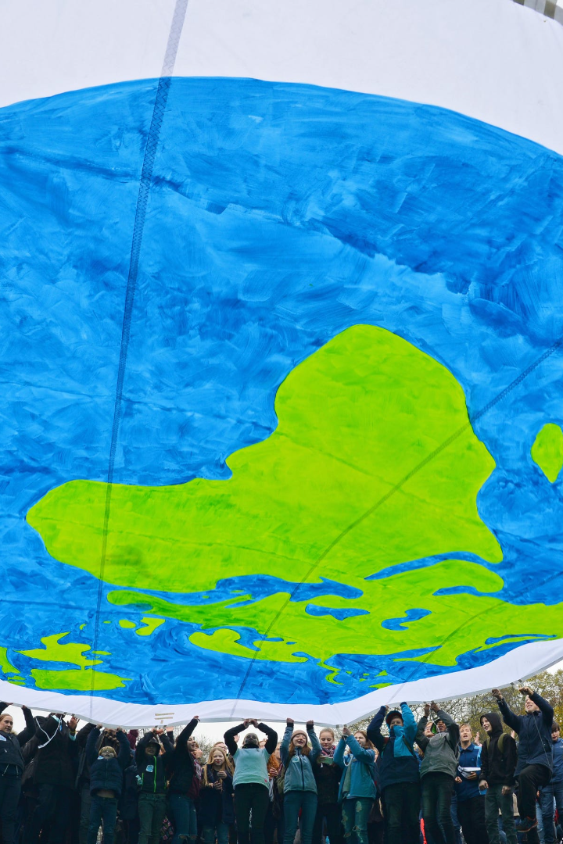
Increasing Threat of Climate Change on the World
Climate change poses a significant risk to our planet and its inhabitants. This presentation explores the causes, impacts, mitigation strategies, adaptation measures, and international efforts related to climate change.

Slide 2

The Importance of the Topic
Understanding the importance of climate change is crucial in addressing the challenges it presents. By recognizing its significance, we can take informed actions to protect our planet and secure a sustainable future.

Slide 3

Advantage and Disadvantage of Climate Change
1
Advantage
Prevents ice age
Ice age is the period in which the temperature drops to an extent that life becomesextremely difficult on Earth. It is believed that there has been five ice ages till datewith regular warmer intervals. The climate change we experience now is a result ofglobal warming where the temperature of the planet is gradually increasing. Thiscould prevent the next ice age from happening.
Lesser injuries due to cold
Every year, a large number of people are hospitalized for illness due to the cold. Extreme conditions could lead to even death. Winters see people affected by frostbite. All these could be escaped with the changing climatic conditions.

Slide 4
Disadvantage
2
Deaths and diseases
The changing conditions of weather have already taken a lot of lives. Many diseasesare caused as the temperature keeps on fluctuating. When the temperaturebecomes too high, the chances of heatstroke rise. It is a condition which causesfever and unconsciousness as the body cannot get adjusted to extreme heat.
Affects plant growth
Plants require an optimum temperature and rainfall to grow well. The recent yearshave seen unpredicted rainfall and weather conditions. This would affect their growthand even lead to their extinction and desertification.

Slide 5
The Impact of Climate Change
1
Rising Temperatures
2
Extreme Weather Events
Searches: heatwave, melting glaciers, temperature records
Searches: hurricanes, floods, droughts
3
Sea Level Rise
Searches: coastal erosion, ocean acidification, sinking islands

Slide 6
Mitigation Strategies
Transition to Renewable Energy
Afforestation
Sustainable Transportation
Searches: tree planting, reforestation initiatives, carbon sequestration
Searches: solar panels, wind turbines, hydroelectric power
Searches: electric vehicles, public transit, bike-sharing programs

Slide 7
Adaptation Measures
Building Resilience
Developing Climate-Resistant Infrastructure
Searches: climate-proof infrastructure, disaster risk reduction, resilient communities
Searches: flood barriers, elevated buildings, green roofs

Slide 8
International Efforts
1
Paris Agreement
Searches: global climate pact, carbon neutrality goals, national contributions
Global Cooperation and Policies
2
Searches: United Nations Framework Convention on Climate Change, climate conferences, emission reduction targets

Slide 9

Conclusion
The urgent need to address climate change cannot be overstated. As individuals and collectively, we must take immediate actions to mitigate and adapt to the impacts of climate change to safeguard our planet for future generations.

